Slide 1

Qlik sense server
(localhost:4848/)
Data
+
Chart
+
content
Data source
Data source
Data source

Slide 2
Qlik sense server
(localhost:4848/)
Web-host
Data
+
Chart
+
Content
Data
Chart
Data source
Data source
Data source

Slide 3
Qlik sense server
(localhost:4848/)
Web-host
Content
Iframe with
URL
Sense App/sheet/chart
Data source
Data source
Data source
App integration/Single integration API

Slide 4
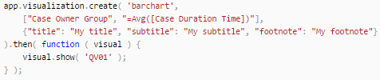
Qlik sense server
(localhost:4848/)
Web-host
App.
visualization
Bar chart
+
Content
Bar chart
Visualization API
Data source
Data source
Data source

Slide 5

Qlik sense server
(localhost:4848/)
Web-host
Web-component
Bar chart
+
Content
Bar chart
Data source
Data source
Data source
Qlik visual

Slide 6
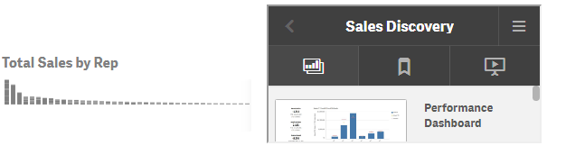
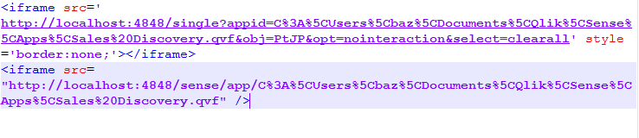
Single integration API (Single chart)
App integration API (App/sheet)

Slide 7
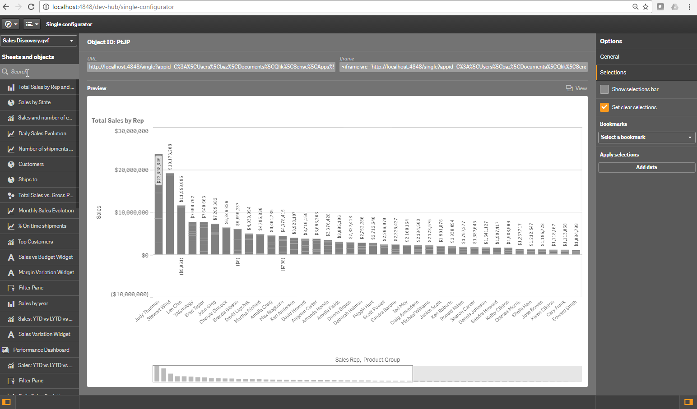
Select App
iFrame content
Select Chart
Option

Slide 8
Qlik sense server
(localhost:4848/)
Web-host
Other resources
resources
Data source
Data source
Data source

Slide 9
Qlik sense server
(localhost:4848/)
Web-host
Font.ftt
Not found
Copy: Css
@font-face
url(<relative path>)
Original: Css
@font-face
url(<relative path>)
Data source
Data source
Data source

Slide 10
Qlik sense server
(localhost:4848/)
Web-host
Font.ftt
Copy:Font.ftt
Resouce: Css
@font-face
url(<relative path>)
Copy: Css
@font-face
url(<modified- path>)
Data source
Data source
Data source

Slide 11
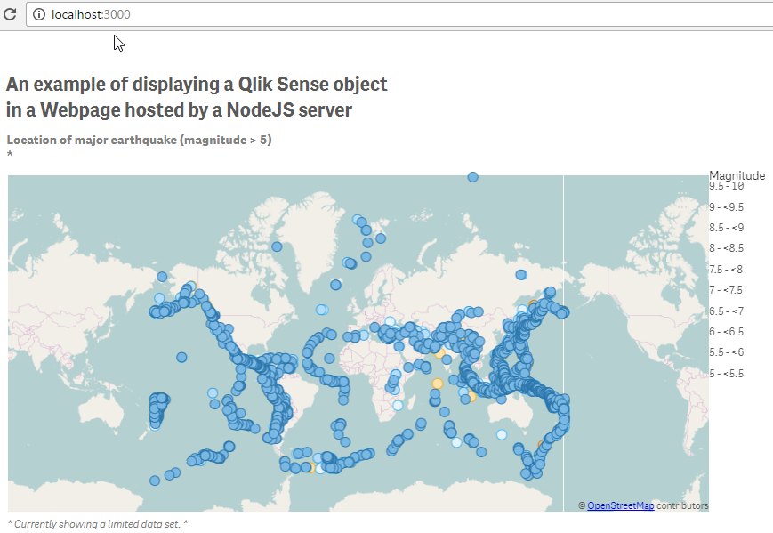
Old

Slide 12
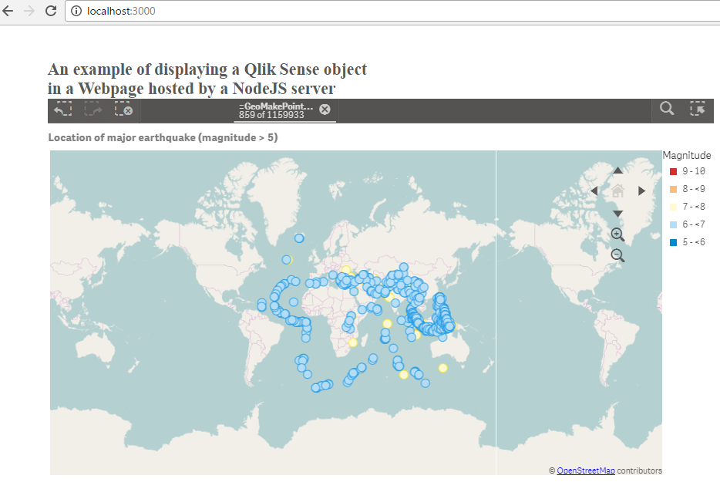
New

Slide 13
Qlik sense server
(localhost:4848/)
Web-host
Create hyperCube
Reply.qHyperCube.qDataPage
Data
hyperCube
Data source
Data source
Data source

Slide 14
